Slide 1

Unlocking Knowledge:
Importance of Basic Science and Translational Research
And its
Impact on Society

Slide 2
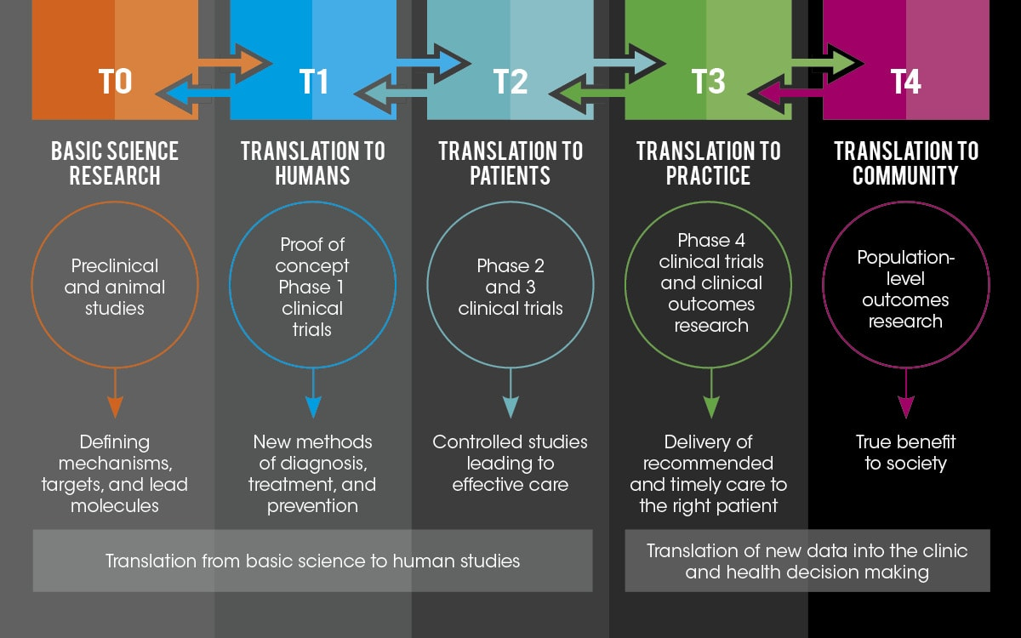
Introduction
Basic Research: Basic research, often referred to as pure science or fundamental research, is a crucial aspect of scientific inquiry aimed at refining scientific theories.
Translational Research: Translational research takes basic science findings and quickly applies them to improve human health. It's all about turning scientific discoveries into real-life solutions
Source: Translational Research Institute (UAMS)

Slide 3
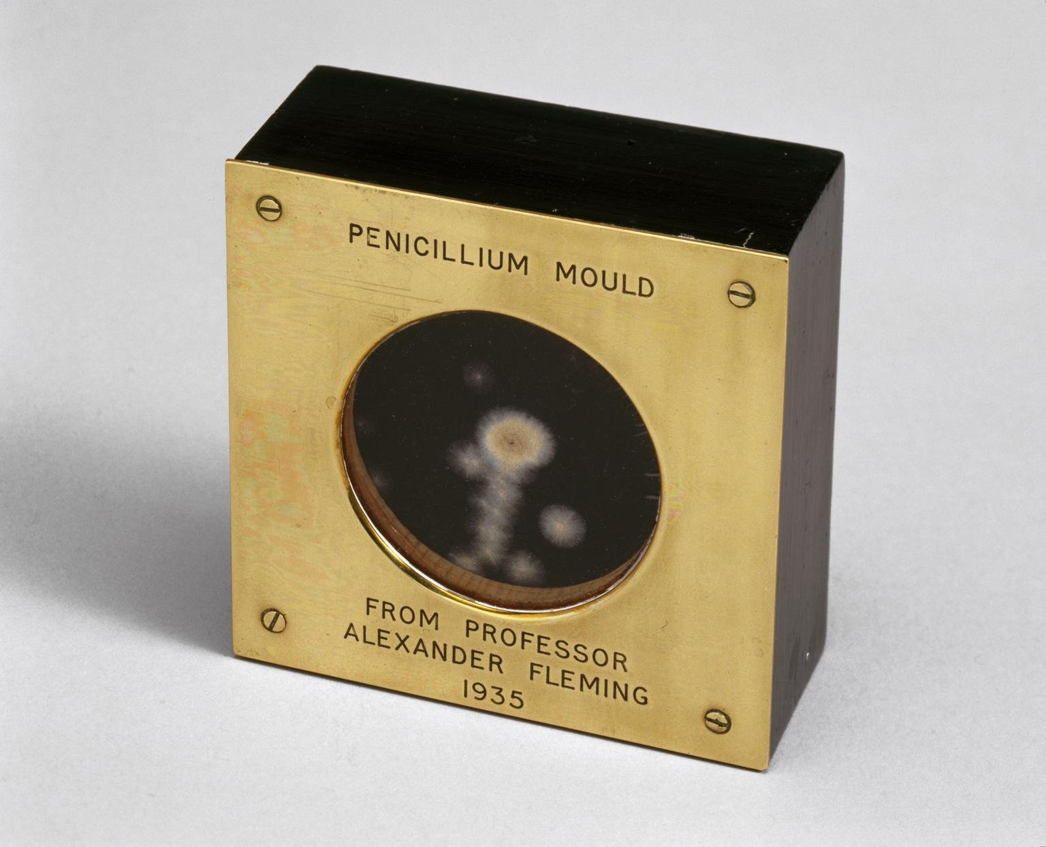
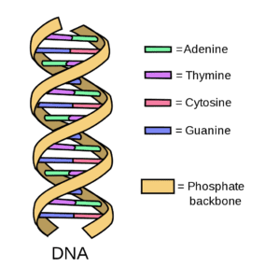
Case Studies
#1 Discovery of Penicillin: Alexander Fleming's basic research on the properties of mold led to the accidental discovery of penicillin in 1928.
#2 Discovery of the Structure of DNA: The basic research conducted by James Watson and Francis Crick, along with the foundational work of Rosalind Franklin and Maurice Wilkins, elucidated the structure of DNA in 1953
Source: sciencemuseum.org.uk
Source: ashg.org

Slide 4
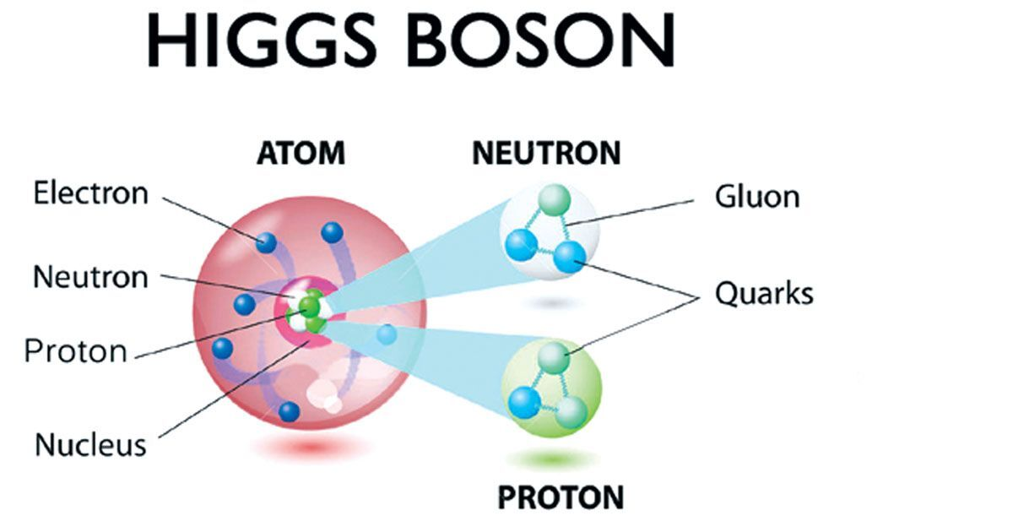
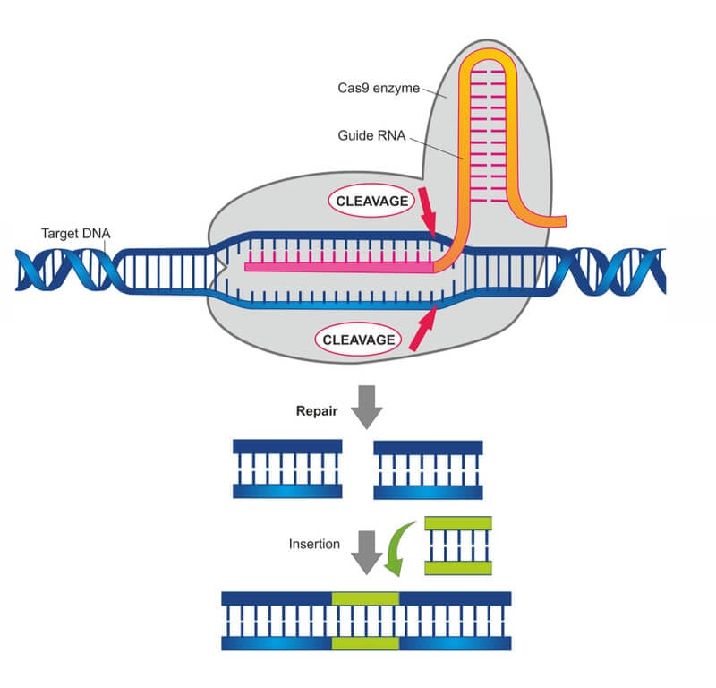
Case Studies
#3 Discovery of the Higgs Boson: The discovery of the Higgs boson, a fundamental particle predicted by the Standard Model of particle physics, was made possible through basic research conducted at the Large Hadron Collider (LHC) at CERN.
#4 CRISPR-Cas9 Gene Editing: Jennifer Doudna and Emmanuelle Charpentier's basic research into the bacterial immune system laid the groundwork for the development of CRISPR-Cas9 gene editing technology.
Source: assamtribune.com
Source: labiotech.eu

Slide 5
Impact on Society
Education: Findings from basic research inform educational advancements, leading to improved teaching methods, development of new learning materials, and a deeper understanding of the world around us.
Healthcare: Basic research in biology, chemistry, and genetics paves the way for understanding diseases, developing new drugs and therapies, and improving preventative measures.
Technology: Exploration of fundamental physics, materials science, and computer science lays the groundwork for future technological breakthroughs in areas like communication, energy production, and artificial intelligence.
Economy: Translational research directly translates scientific discoveries into new products, processes, and industries, driving economic growth and creating new job opportunities.

Slide 6
Thank You Everyone
I Hope You Enjoyed the Presentation on Basic Science and Translational Research

Slide 7
Unlocking the Inquiry Door

